Slide 1

An Algorithmic
Approach to Wordle
Presented by
Eric Helser
2023-10-06

Slide 2
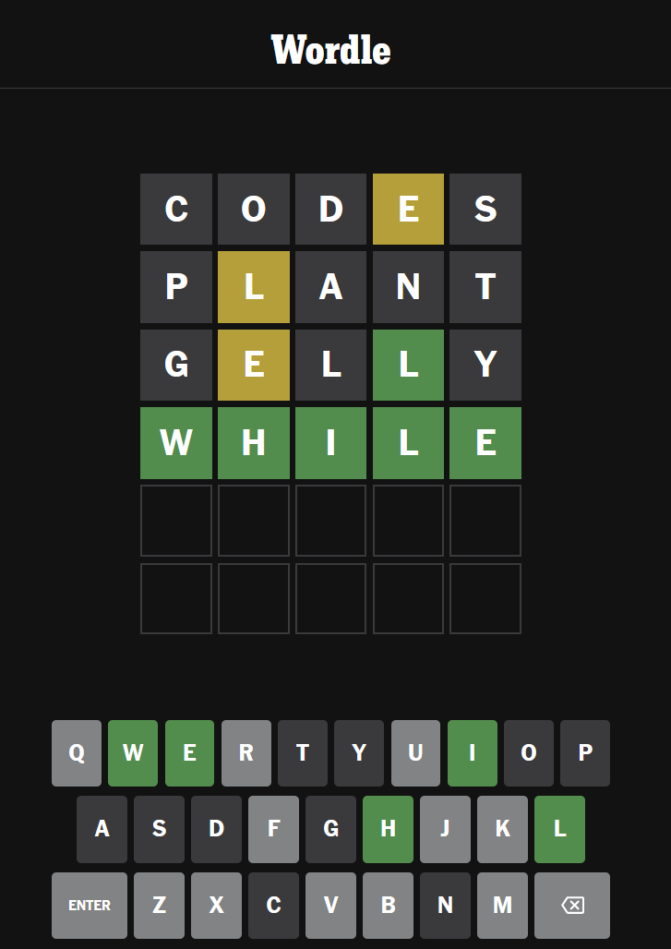
What is Wordle?
Word-based puzzle game, initially released by Josh Wardle in October 2021
Went viral online over the winter and was acquired by NYT in January 2022
Guess the hidden word in 6 tries
Mastermind, Lingo
Only valid 5-letter words are allowed
Clues provided after each guess:
Green: Letter is correct in this spot
Yellow: Letter appears elsewhere
Gray: Not in solution

Slide 3
What are we trying to accomplish here?
Java command-line application
Minimize the number of guesses necessary
Can we guarantee a win?
(Always guess the word within 6 attempts)

Slide 4
Document Game Flow
Legal Guesses
Determine Optimal
Guess
Guess = Solution?
Yes
6 or fewer Guesses?
Yes
Start
Win!
No
No
Lose
Filter Possible Solutions Based on Result

Slide 5
Implement GuessEvaluator
“Solution”
J
U
D
G
E
“Guess”
“Result”
(YGY--)
G
U
E
S
S
GuessEvaluator
G
U
E
S
S
Approach:
Mark CORRECT letters
Mark PRESENT letters
Of the unmatched Solution letters, are any present in the player’s Guess?
Edge case: letters that appear multiple times
Mark MISSING letters
Test-Driven Development
We have sample data already
Can verify as we code

Slide 6
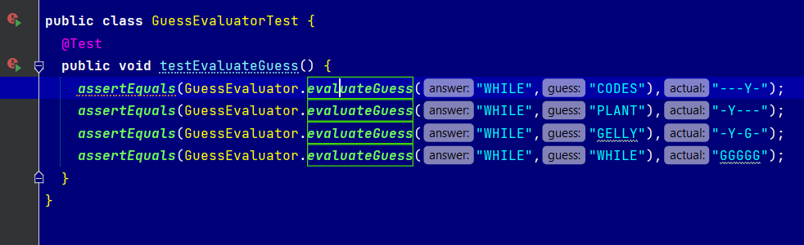
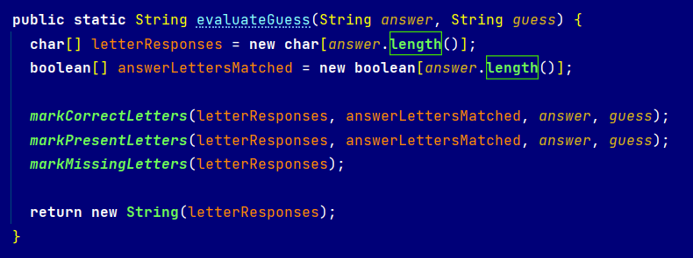
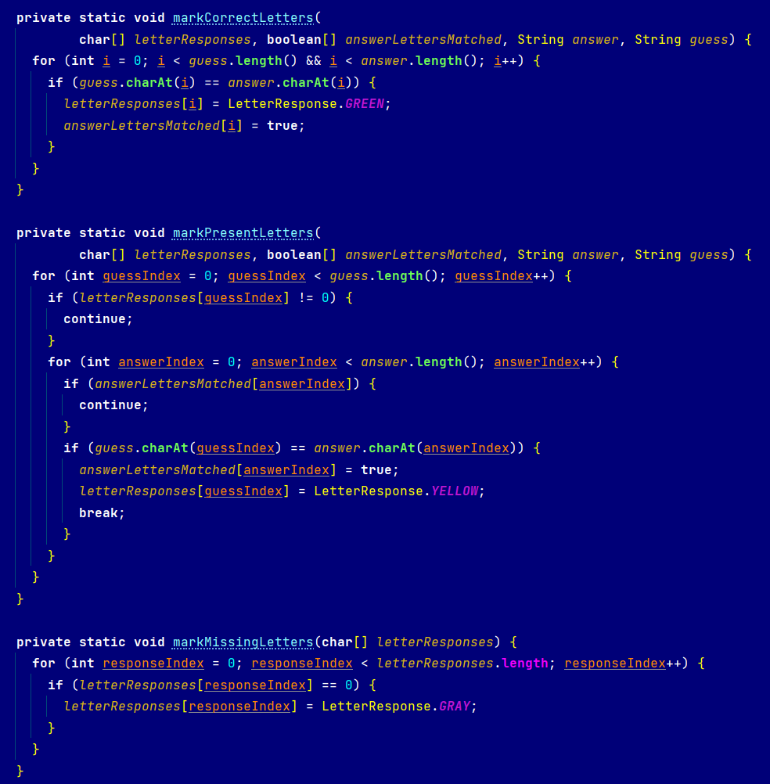
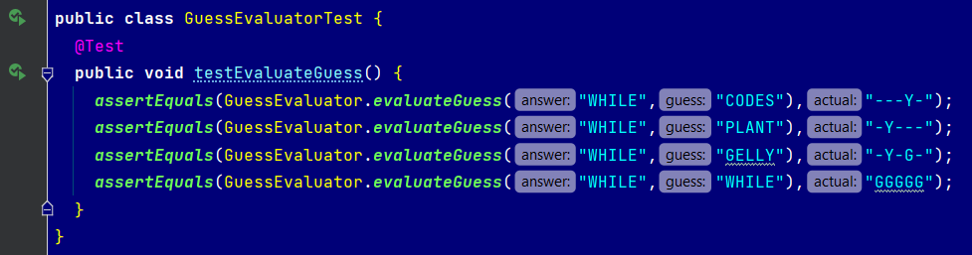
GuessEvaluator TDD
Our Wordle game from earlier, with a failing unit test
Test is now successful after implementing evaluateGuess()

Slide 7
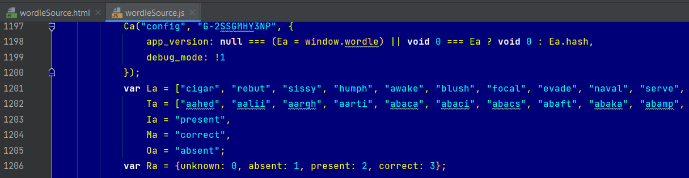

Implement Dictionary
Collect sets of legal input words and possible solutions
Available in Wordle source code
Separate lists for daily solutions and other allowable inputs
Legal Words
12972
Solution Set
Dictionary object is a wrapper for a List of Strings
Dictionary 1: Legal Guesses
Dictionary 2: Remaining Possible Solutions
2315

Slide 8
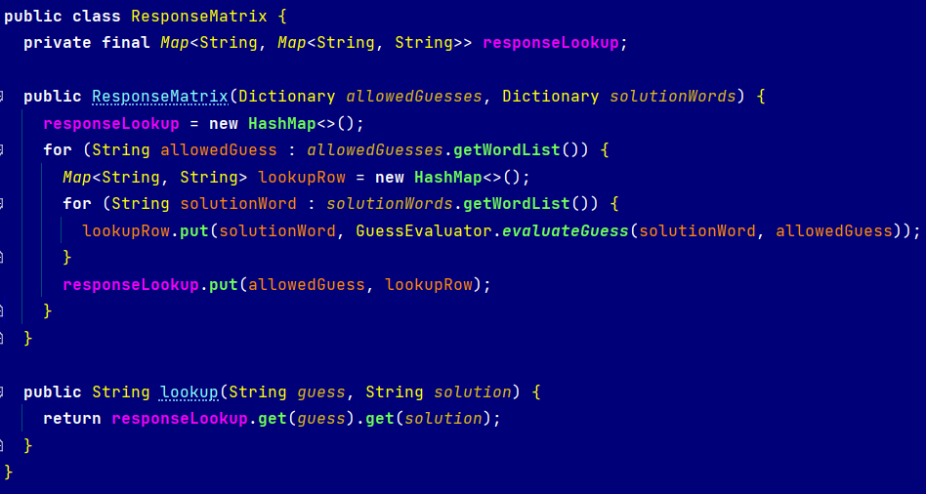
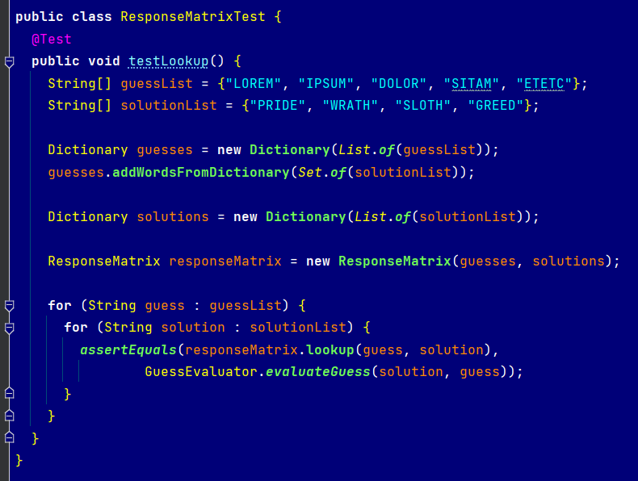
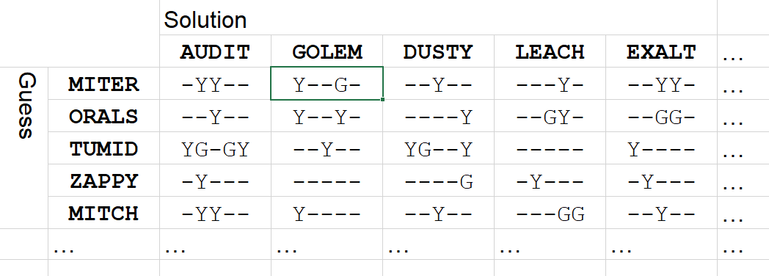
Implement ResultMatrix
Trade-off:
Do we want to evaluate each guess every time?
Computation-intensive
We can precompute all guess/solution pairs ahead of time based on Dictionary objects
12972 guesses × 2315 solutions ≈ 30 million records

Slide 9
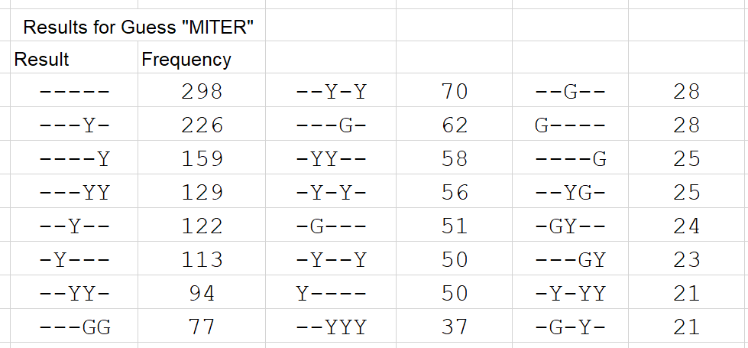
Result Distribution
ResultMatrix
contents
Now that we have every possible input/output pair, we can determine the ideal guess in any scenario.
Each Guess yields one of 243 (=3⁵) Results
Given there are 2315 possible Solutions, then each Result for a Guess may correspond to one or more Solutions.
M
I
T
E
R
There are only 58 Solution words that would give us this Result for the Guess MITER:
AUDIT SHIFT FOIST SWIFT WAIST TOPIC SAINT AWAIT TUNIC
TACIT ITCHY TYING JOINT TULIP PAINT JOIST PLAIT HOIST
FAITH SPLIT UNFIT FLINT FAINT POSIT TOXIC TOXIN GUILT
THING THINK GLINT INGOT TONIC POINT QUILT TAINT STOIC
CACTI TWIXT INPUT UNITY BLITZ TWIST STIFF SPILT STICK
IDIOT STILT STILL HABIT STINT STING STINK BUILT UNLIT
THIGH STAIN STAID THICK
Result Distribution

Slide 10
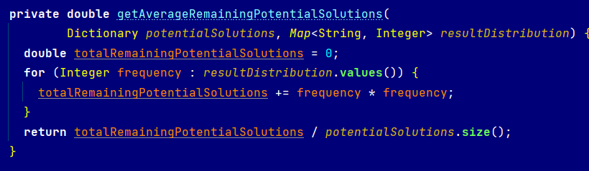
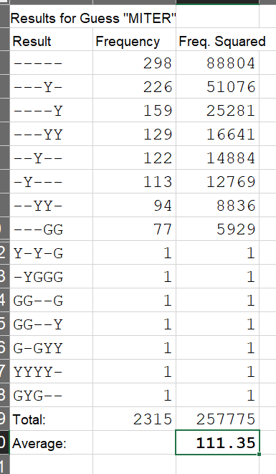
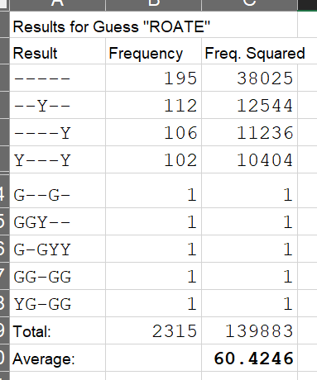


Guess Optimization
What Guess reduces the search space the most?
Strategy #1: Find the Guess that minimizes the average remaining Solution set size
Given Result r, let $F_{r}$ be the frequency of r among all potential Solutions. Each of those reduce the remaining Solution size to $F_{r}$, so goal is to find a Guess that minimizes:
$$\frac{\sum{{F_{r}}^{2}}}{\sum{F_{r}}}$$
R
O
A
T
E

Slide 11
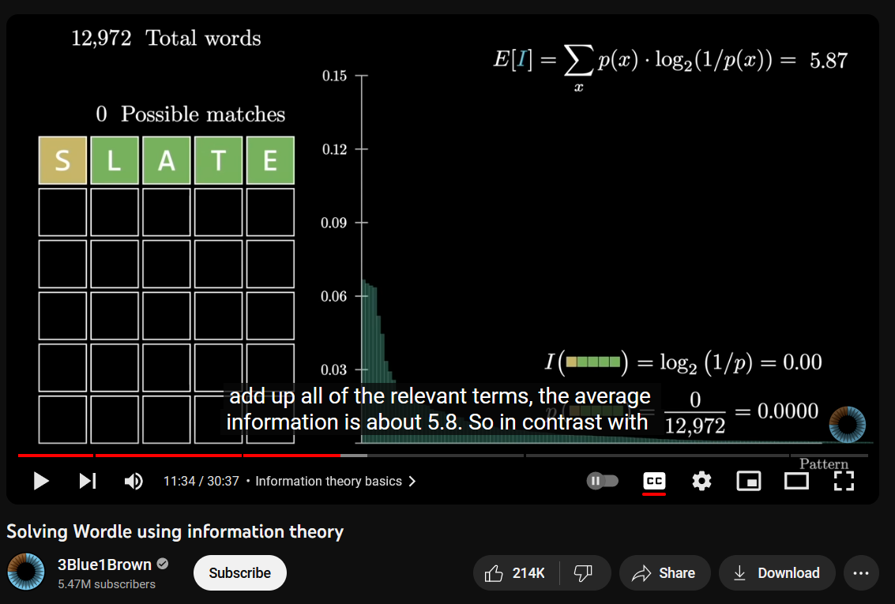
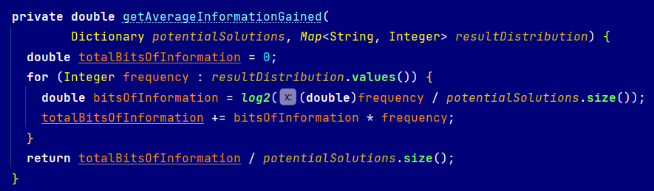
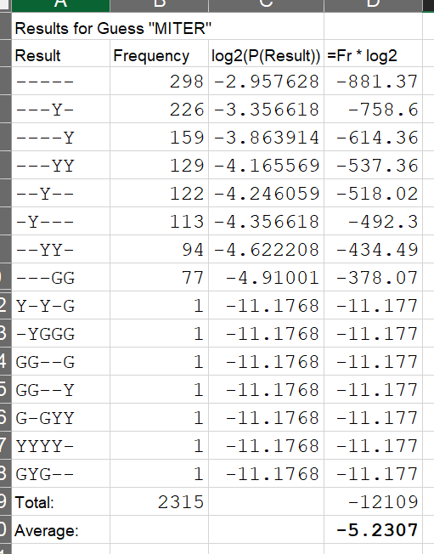



Guess Optimization
It looks like there has been some other research on this topic. We can revise our Guess metric to validate our logic is consistent with this study.
Strategy #2: Find the guess that maximizes the number of Bits of Information gained
1 bit of information = Reduction in search space by ½
$$\frac{\sum{\left({F_{r}∙log}_{2}\left(\frac{F_{r}}{\sum{F_{r}}}\right)\right)}}{\sum{F_{r}}}$$
$$\frac{\sum{{F_{r}}^{2}}}{\sum{F_{r}}}$$
$$\log_{2}\frac{111.35}{2315}≈−4.26$$

Slide 12
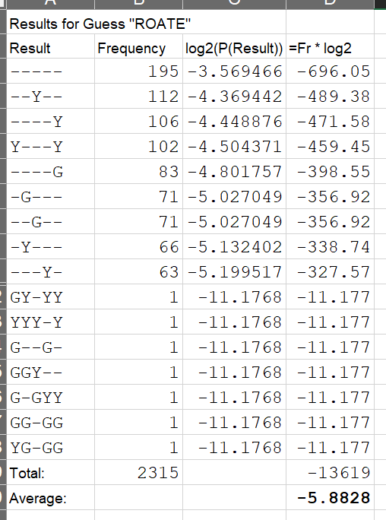
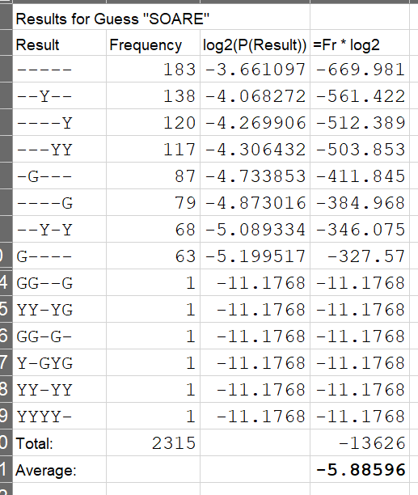
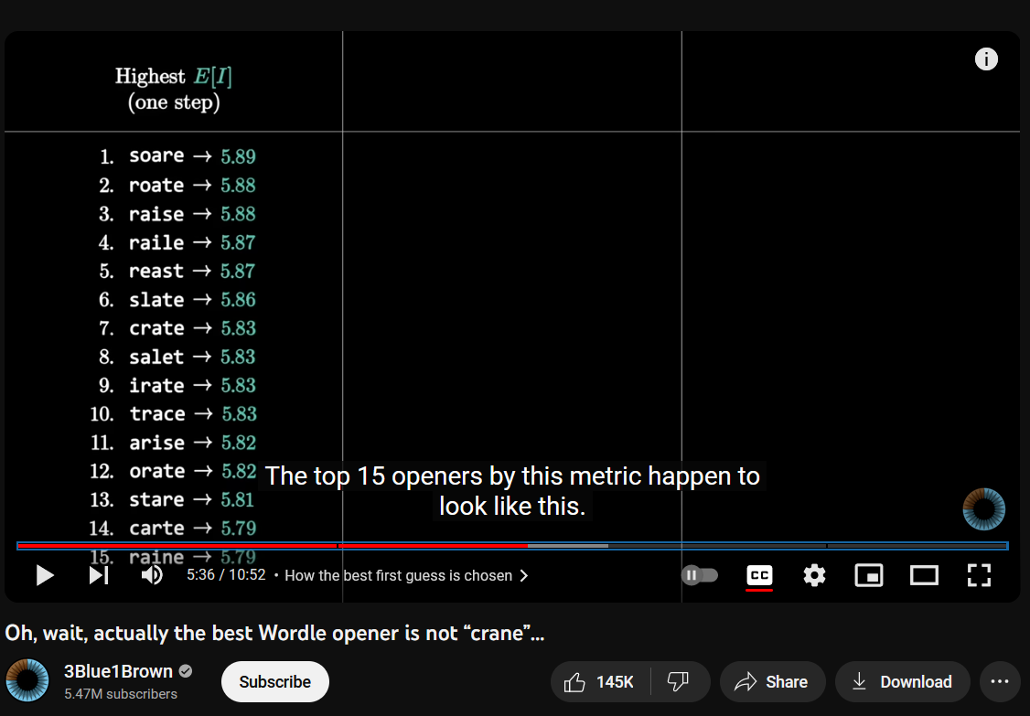

Verification
Does this change the best initial Guess?
Verifying that my results match a similar study:
R
O
A
T
E
S
O
A
R
E

Slide 13
Let’s Play Wordle
Legal Guesses
Generate Result Matrix
Determine Optimal
First Guess
Guess = Solution?
Yes
6 or fewer Guesses?
Yes
Win!
Possible Solutions
No
No
Determine Optimal
Subsequent Guess
Lose
Filter Possible Solutions Based on Result
Solutions Remaining:
2315
S
O
A
R
E
40
C
L
I
N
K
2
M
A
L
I
K
1
C
H
A
M
P

Slide 14
Results
S
O
A
R
E
Room for improvement:
If multiple optimal candidates are found, optimize for subsequent Guesses
When only two possible Solutions remain, take the 50/50 guess
T
A
L
A
R
P
I
G
M
Y
W
A
R
R
E
F
O
N
D
U
W
A
V
E
R
One of the Solutions it struggled with…

Slide 15
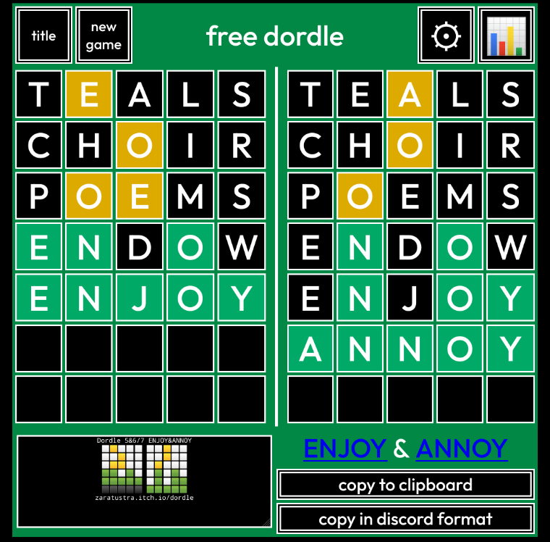
Next Step: Two at Once?
Introducing Dordle:
“Double Wordle”
Slightly different word lists
Wordle: 12972 words, 2315 solutions
Dordle: 13258 words, 2344 solutions
Same rules
Solve both puzzles simultaneously
After one puzzle is solved, this becomes normal Wordle
One extra guess allowed
Using the same approach:
Can we guarantee a win every time?
Which strategy is better: focus on one puzzle at a time, or reduce the overall search space?

Slide 16
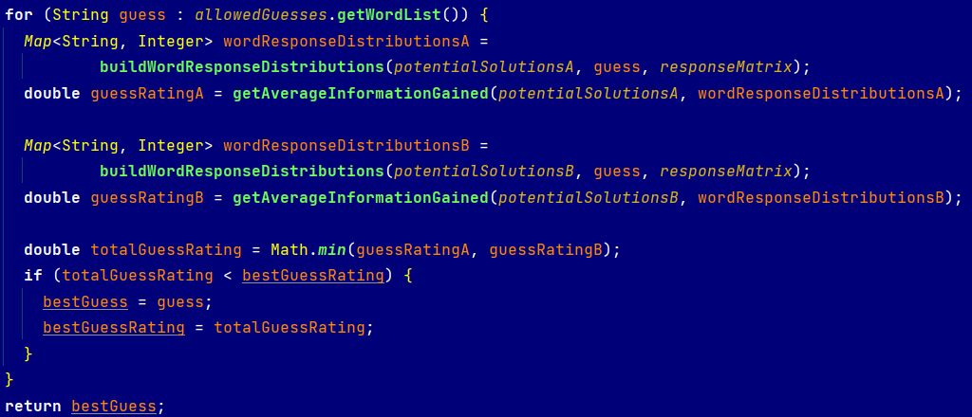
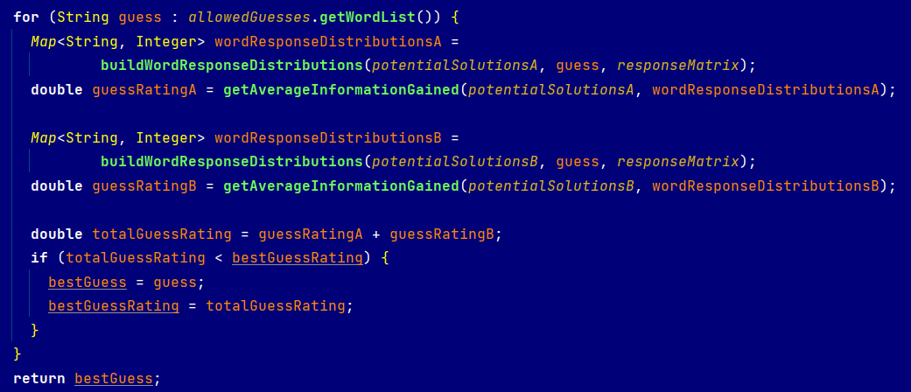
Guess Optimization (×2)
Continue using Bits of Information metric
Option 1: Divide and Conquer
Select the Guess that reduces one of the possible Solution sets by the most
Option 2: All At Once
Select the Guess that reduces the space of possible Solution-pairs by the most

Slide 17
Dordle Results
Avg:
4.92
5.25
5.78
Games:
1804
9147
128

Slide 18
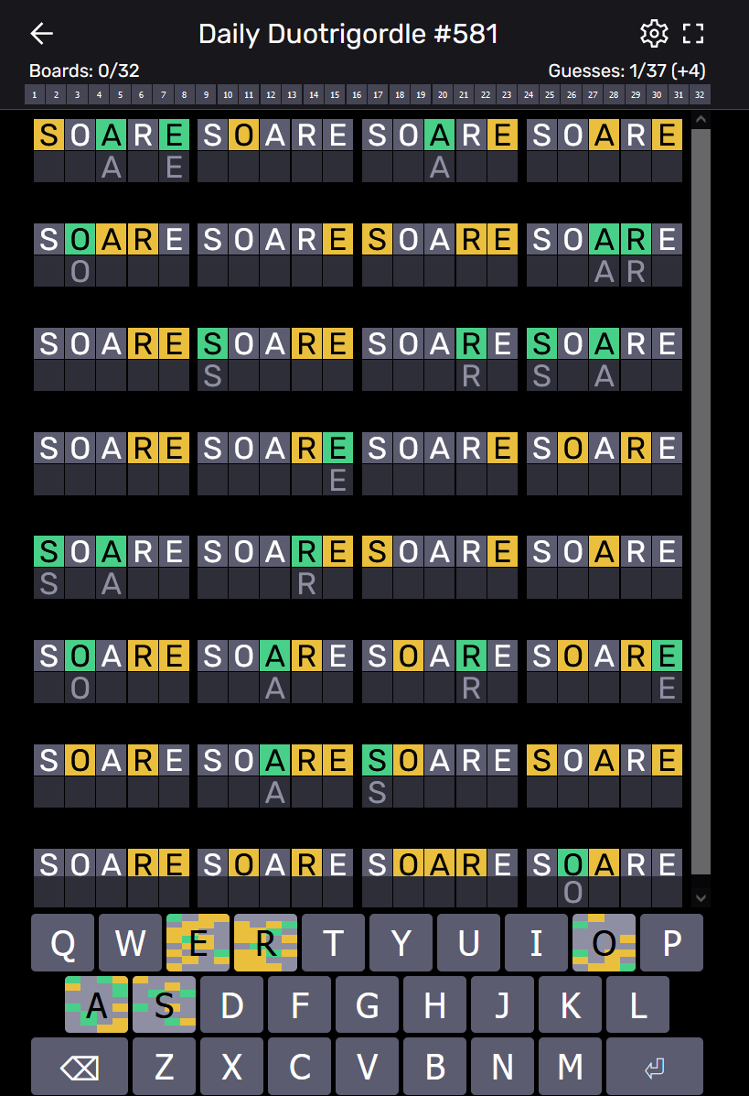
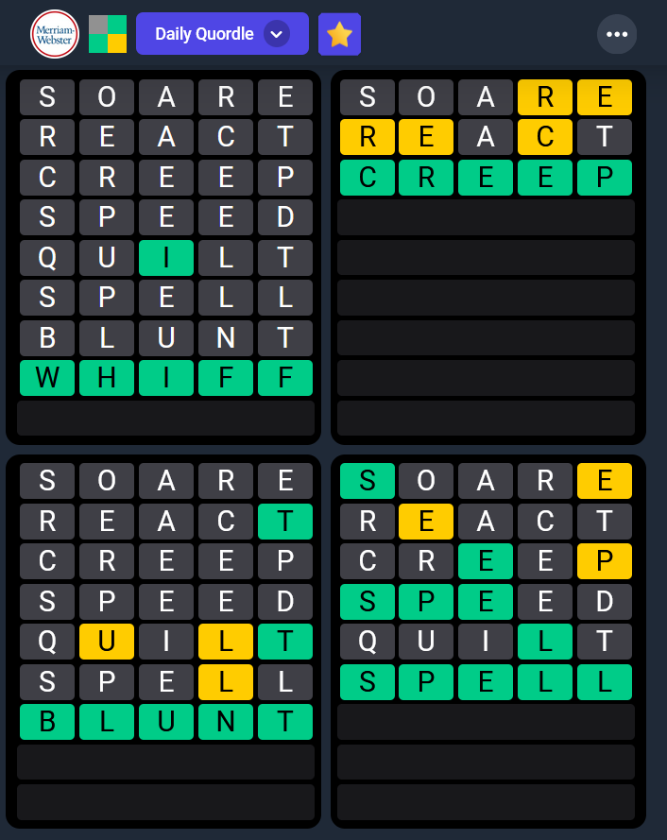
To Infinity And Beyond…

Slide 19

Thank you!
Source code available at
github.com/erichelser
Questions?

